Slide 1
Switching wells in rural bangladesh
Critical thinking group 2
December 20, 2019

Slide 2

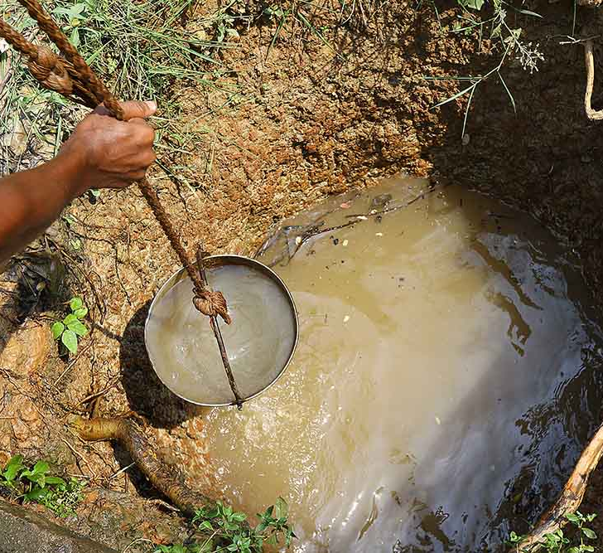
introduction
Access to safe drinking water is a public crisis.
785 million people (1 in 9) lack access to safe water.
Solutions from developed nations are too expensive.
Water crisis is an economic problem.
Notes:
Image source: https://undark.org/2017/08/16/bangladesh-arsenic-poisoning-drinking-water/
785 million people with lack of access to safe water: https://water.org/our-impact/water-crisis/

Slide 3
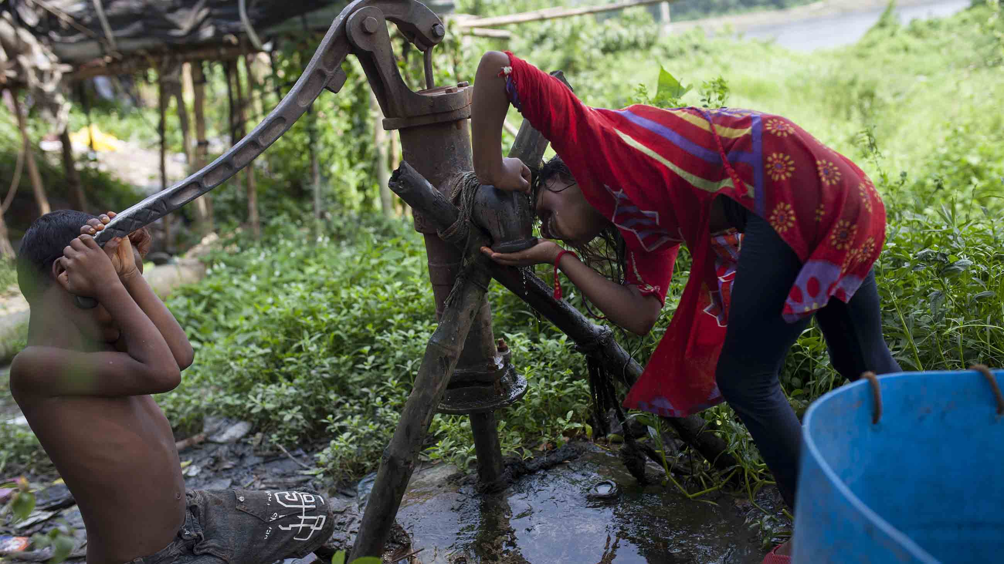
Arsenic in drinking water in bangladesh
Bangladesh’s contaminated well water is considered one of the largest public health crises in the world.
Arsenic contamination discovered in the 1990s.
An estimated 40 million people are exposed to drinking water contaminated with arsenic.
Arsenic is odorless and tasteless.
Trace arsenic exposure have led to increase in cancers (skin, liver, lung), cardiovascular disease, and in developmental and cognitive problems for children.
Notes:
Source: https://undark.org/2017/08/16/bangladesh-arsenic-poisoning-drinking-water/

Slide 4
Arsenic in drinking water in bangladesh
The World Health Organization (WHO) considers water with concentration higher than 10 micrograms per liter as unsafe.
Bangladesh arsenic safety standard is above 50 micrograms per liter.
The Bangladesh Arsenic Mitigation and water Supply Program (BAMWSP) surveyed millions of tubewells and identified wells as safe or unsafe.
Safe wells were built by drilling deeper wells.
Household survey responses in Araihazar upazila indicate roughly half the affected households switched to safe wells.
Survey also showed that significant number of households did not stop drinking from unsafe wells after they had learned that it was unsafe.

Slide 5
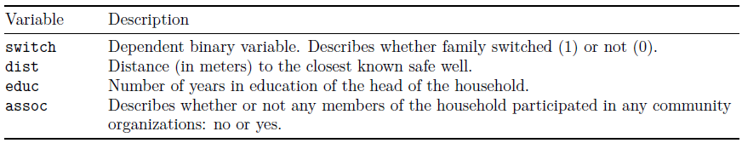
Well switching data
This data set describes whether or not households in Bangladesh switched to safe wells.
http://www.stat.columbia.edu/~gelman/arm/examples/arsenic/wells.dat
3,020 observations.

Slide 6
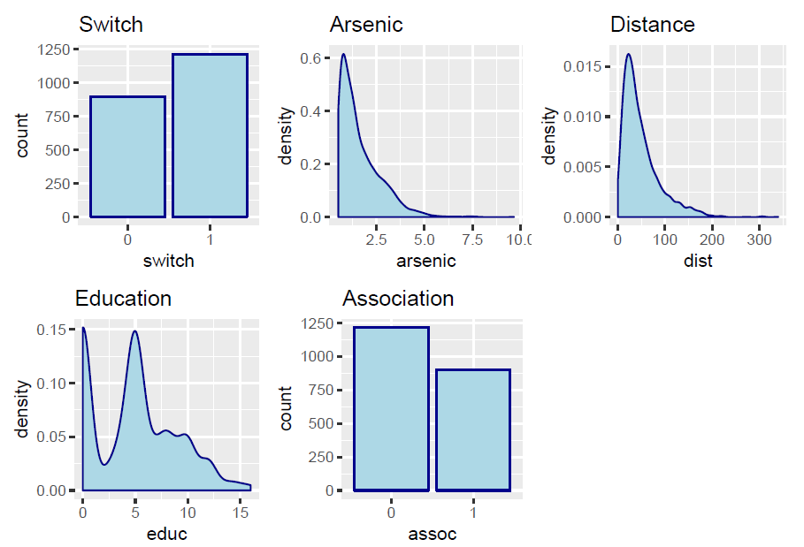
DATA Exploration
Distribution
There are more households that switched.
Majority of households had original wells with arsenic levels less than 2.5 (hundreds of micrograms per liter).
Most of households are less than 100 meters away from the nearest safe well.
Households can be roughly grouped into those with less than 2.5 years of education, those with 2.5 to 7.5 years of education, and those with more than 7.5 years of education.
There are less households with associations to the community.

Slide 7
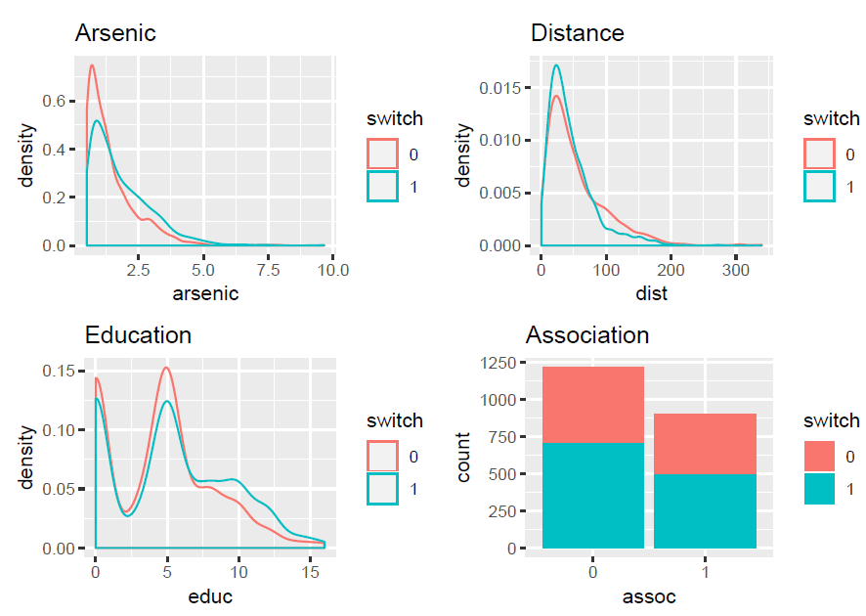
DATA EXPLORATION
Distribution (grouped by switch)
There is an arsenic threshold where more households tend to switch (roughly around 2).
Households that are closer to safe wells have a higher proportion of switching.
There is a threshold in distance where we start to see less households switching (roughly around 75 meters).
There is an education threshold (around 6 years) where we see a higher proportion of switching

Slide 8
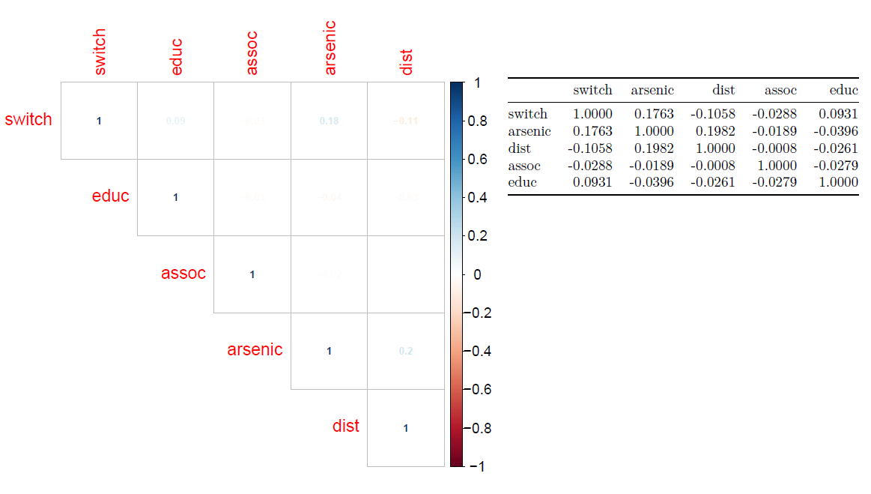
Correlation
None of the variables appear to be strongly correlated to each other.
Arsenic and switch have a positive correlation.
Education and switch have a positive correlation.
Distance and switch have a negative correlation.
Association and switch have a negative correlation.

Slide 9
Building predictive models to identify high-risk households
Survey responses have showed that a significant number of households did not stop drinking from unsafe wells even after they had learned that the water was unsafe.
The predictive models should assist community organizations in identifying households that are high-risk for not switching to safe wells.
Predictive models will use arsenic, distance, education, and association of a household to predict if a household switched or not.
The selected model will assign a household to one of three categories (likely to switch, somewhat likely to switch, and unlikely to switch) based on the predicted probability of switching.

Slide 10
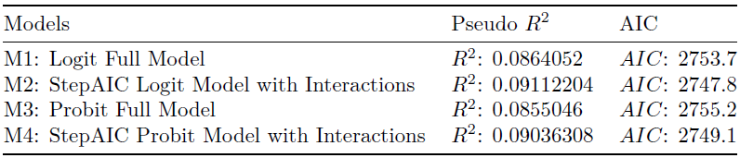
Models
Four models were built to predict whether or not a household switched wells.
Two are Logit binary regression models.
Two are Probit binary regression models.

Slide 11
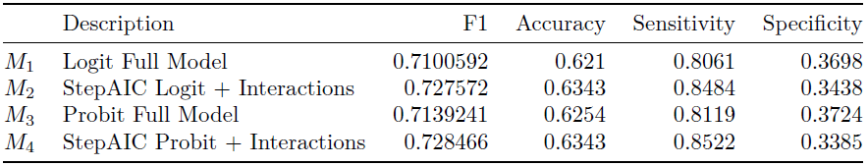
Evaluation
The data set is split into training and testing set (70 and 30 percent respectively).
The selected model is M4, with the highest F1 score.
Model M4 is a StepAIC Probit binary regression model with variable interactions.

Slide 12
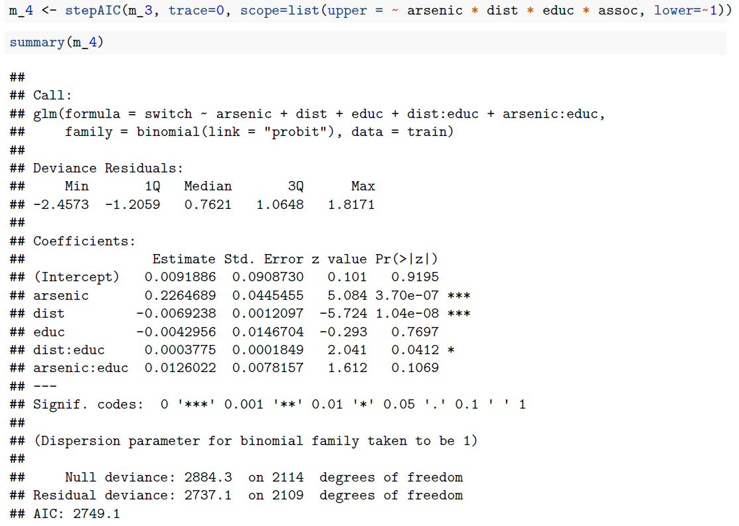
Selected Model

Slide 13
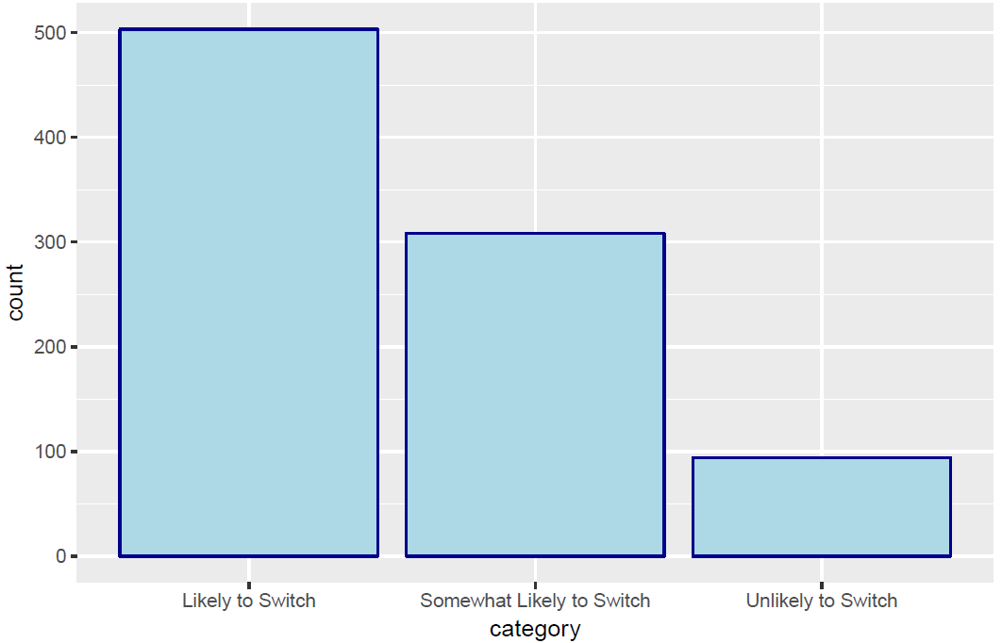
Household risk
Model M4 was used to predict probability of switching.
Household is assigned to one of three categories: (1) likely to switch (> 0.55), (2) somewhat likely to switch (=< 0.55 and => 0.45), and (3) unlikely to switch (< 0.45).
Assigning households to different risk categories should help community organizations identify potential households that may require a more tailored approach depending on their risk level in order for these households to switch to safe wells.

